Slide 1


HuBMAP + HPA - Hacking the Human Body Competition Progress Report FINAL
Presentation of a Report
By
Kaggle Group
Notes:
English Title: Uppercase, Calibri size 60, XJTLU Navy
English Subtitle: Uppercase, Calibri size 36, XJTLU Navy

Slide 2
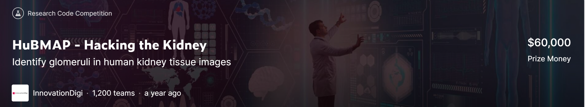

Overview
New Dataset:
1. The dataset that combine data with and without color normalization
New Channel:
1. Add two additional channels
Large Size:
1. Using The Larger Size Image to Train The Model
Future Plan:
1. Happy Endings
2. Continue to finish the rest plan
Notes:
Header: Uppercase, Calibri size 28, XJTLU Navy
Body Text: Sentence case, Calibri size 14, Black

Slide 3


Part 1: New Dataset:
Original Dataset: Color Only From HPA
UNext50 Use Original Dataset
New Dataset: Color From HuBMAP And HPA
UNext50 Use New Dataset
Notes:
Header: Uppercase, Calibri size 28, XJTLU Navy
Key Text: Title case, Calibri Bold size 14, Black
Charts and tables should use the XJTLU colour palette

Slide 4
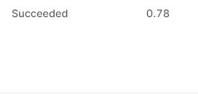
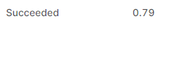
Part 1: New Dataset:
The Results of Using New Dataset:
EfficientNet B7 Use Original Dataset
Efficient B7 Use New Dataset
Notes:
Header: Uppercase, Calibri size 28, XJTLU Navy
Key Text: Title case, Calibri Bold size 14, Black
Charts and tables should use the XJTLU colour palette

Slide 5
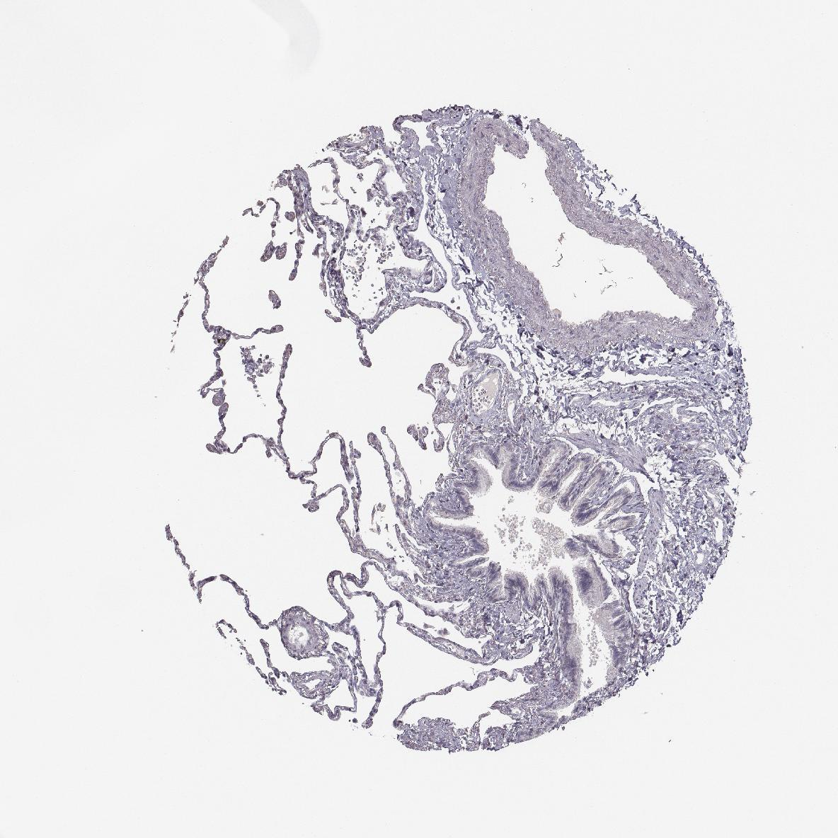
Part 2: Muti-Modal
Process Methods:
Part 2: New Channels:
1
1
1
0
0
0
1
1
1
1
1
1
0
0
0
0
0
0
0
0
0
1
0
0
0
1
1
1
1
1
0
0
0
0
0
0
0
0
0
0
0
0
0
0
1
0
0
0
0
1
1
0
0
0
0
0
0
0
0
0
0
0
0
0
0
0
0
0
0
0
0
0
1
1
1
0
0
0
0
0
0
0
0
0
0
0
0
0
0
0
0
0
3
4
5
0
0
1
1
1
0
0
0
0
0
0
0
0
1
4
5
1
1
1
7
6
3
0
0
0
0
1
1
1
0
0
1
7
4
7
8
3
0
1
1
1
1
2
3
0
0
3
8
9
1
1
1
1
9
3
1
6
3
RGB Image (Lung Sample)
Additional Seven Channels
Change the input data channel from 3 to 10
Notes:
Header: Uppercase, Calibri size 28, XJTLU Navy
Key Text: Title case, Calibri Bold size 14, Black
Charts and tables should use the XJTLU colour palette

Slide 6

Part 2: New Channel:
The Results of Using New Channel:
EfficientNet B7 Use New Dataset But No Two Additional Channels
Efficient B7 Use New Dataset With Two Additional Channels
Notes:
Header: Uppercase, Calibri size 28, XJTLU Navy
Key Text: Title case, Calibri Bold size 14, Black
Charts and tables should use the XJTLU colour palette

Slide 7

Part 3: Larger Size:
DISTRIBUTED TRAINING
The larger the image the more pixel information can be retained.
And to train large images, we need a GPU with larger cuda memory.
So we use two A40*2 for distributed training.

Slide 8
Part 3: Larger Size:
DISTRIBUTED TRAINING
Result display:
The image with 1536x1536 size have bad performance.

Slide 9
Part 3: Larger Size:
DISTRIBUTED TRAINING
Result display:
The image with 1280x1280 size have improved the performance.

Slide 10
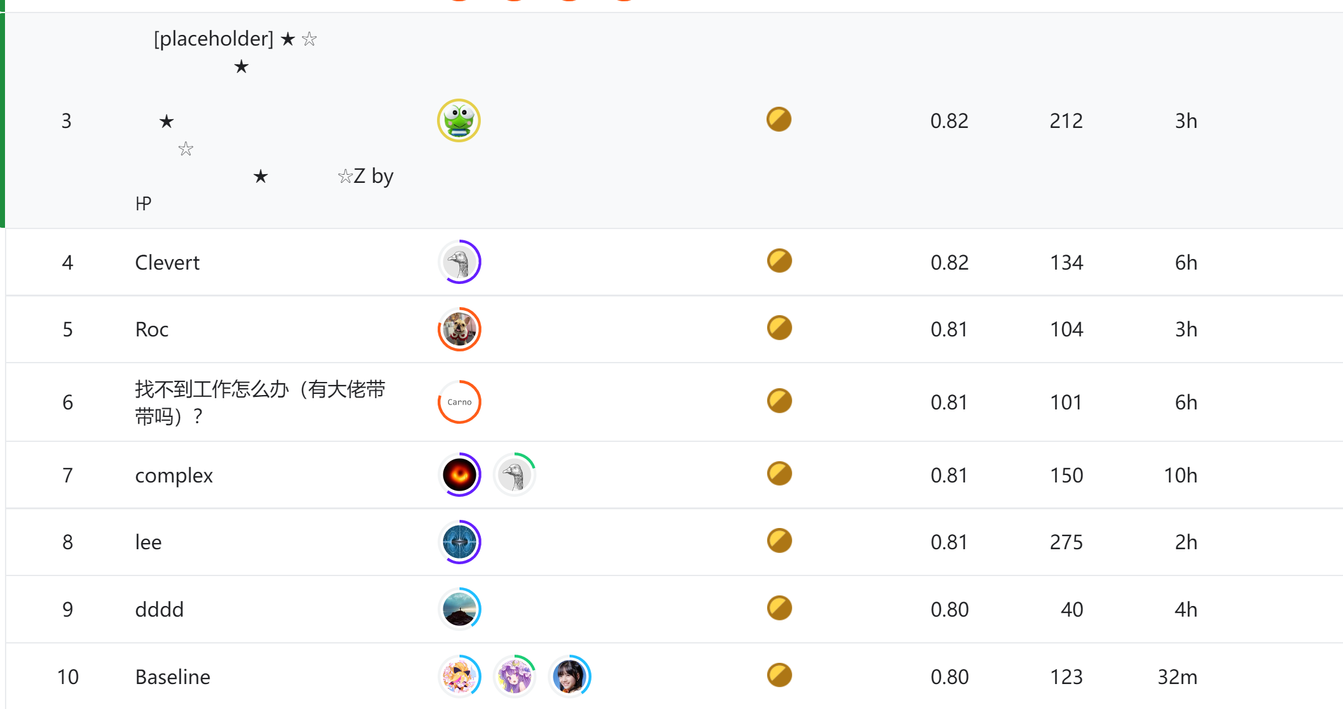
Part 4: Future Plan
Continue to finish the rest plan!
Happy Ending!
Notes:
Header: Uppercase, Calibri size 28, XJTLU Navy
Key Text: Title case, Calibri Bold size 14, Black
Charts and tables should use the XJTLU colour palette

Slide 11
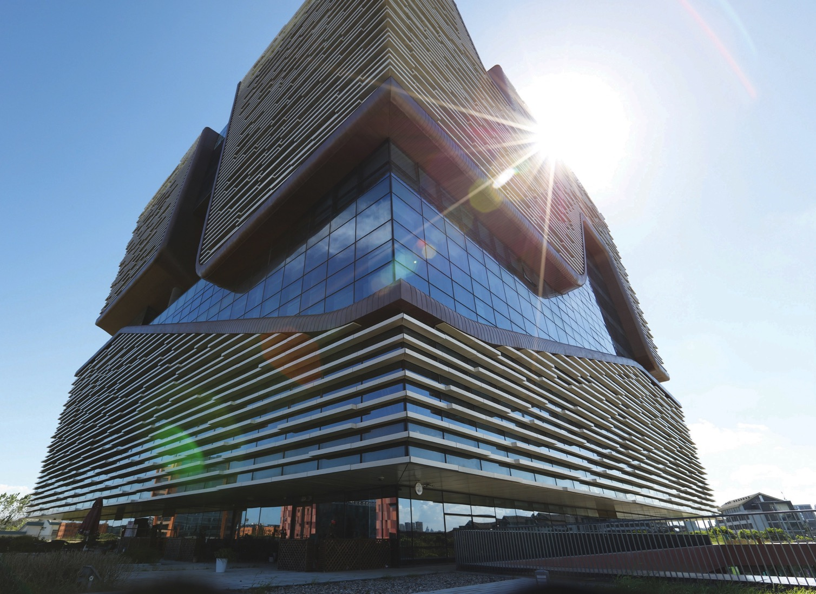
Thank you !

